Slide 1
SPAM purification

Slide 2
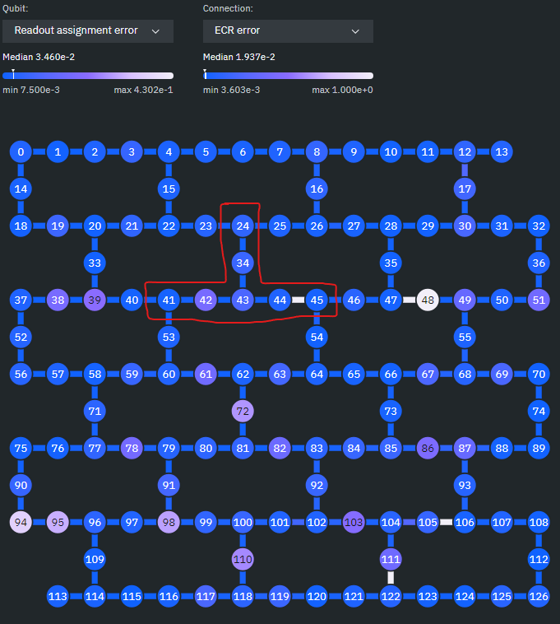
 | manual qubit allocation [S,A1,…] = [43,42,34,44,41,24,45]
 | real 'ibm cusco'
m | n | #CNOTs | ASRm | ASRv | FIDm | FIDv
0 | 0 | 0 | 1 | 0 | 0.93023682 | 0.00001443
0 | 1 | 1 | 0.83524658 | 0.00002695 | 0.96437762 | 0.00000652
0 | 2 | 2 | 0.72501221 | 0.00134312 | 0.98288625 | 0.00000381
0 | 3 | 3 | 0.7064502 | 0.00004077 | 0.99185949 | 0.00000288
1 | 0 | 1 | 1 | 0 | 0.9282641 | 0.00001156
1 | 1 | 2 | 0.83428711 | 0.00004039 | 0.97129978 | 0.00001378
1 | 2 | 3 | 0.75131836 | 0.00016478 | 0.98319918 | 0.00000553
1 | 3 | 4 | 0.68064453 | 0.00017263 | 0.99017415 | 0.00001259
2 | 0 | 2 | 1 | 0 | 0.93435239 | 0.00002702
2 | 1 | 3 | 0.83697266 | 0.00002928 | 0.97409248 | 0.00000766
2 | 2 | 4 | 0.73223389 | 0.00029871 | 0.98384276 | 0.00000969
2 | 3 | 5 | 0.66999268 | 0.00030578 | 0.99259423 | 0.00000186
3 | 0 | 3 | 1 | 0 | 0.94370913 | 0.00001951
3 | 1 | 4 | 0.80861328 | 0.00009745 | 0.97457565 | 0.00000675
3 | 2 | 5 | 0.67683594 | 0.00088368 | 0.9929463 | 0.00000321
3 | 3 | 6 | 0.51229248 | 0.00519504 | 0.98930218 | 0.00001426

Slide 4
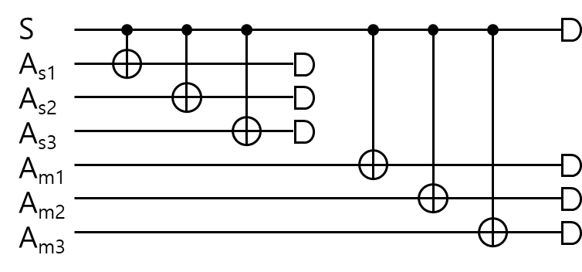
Single qubit state |0> preparation M: additional qubits for measurement purification N: additional qubits for state purification 8192 shots, “ibm_cusco” 2024-06-04 22:00 ~ 22:06
|SA_{s1}A_{s2}A_{s3}A_{m1}A_{m2}A_{m3}>
(*) SAR (State Acceptance Rate) = #AcceptedStates / #shots (%) (**) MAR (Measurement Acceptance Rate) = (#0^{(m)} + #1^{(m)}) / #AcceptedStates (%) (***) Purified fidelity = #0^{(m)} / (#0^{(m)} + #1^{(m)})
M | N | #CNOTs | #Accepted States | #0^{(M)} outcome | #1^{(M)} outcome | SAR^{(*)} (%) | MAR^{(**)} (%) | Purified fidelity^{(***)}
0 | 0 | 0 | 8192 | 7868 “0” | 324 “1” | 100 | 100 | 0.960449
0 | 1 | 1 | 7965 | 7727 “00” | 238 “10” | 97.2290 | 100 | 0.970119
0 | 2 | 2 | 7007 | 6959 “000” | 48 “100” | 85.5347 | 100 | 0.993150
1 | 0 | 1 | 8192 | 7736 “00” | 66 “11” | 100 | 95.2393 | 0.991541
1 | 1 | 2 | 7964 | 7380 “000” | 124 “101” | 97.2168 | 94.2240 | 0.983475
1 | 2 | 3 | 6308 | 5712 “0000” | 115 “1001” | 77.0020 | 92.3748 | 0.980264
2 | 0 | 2 | 8192 | 7027 “000” | 483 “111” | 100 | 91.6748 | 0.935686
2 | 1 | 3 | 7115 | 5801 “0000” | 279 “1011” | 86.8530 | 85.4533 | 0.954112
2 | 2 | 4 | 7004 | 448 “00000” | 29 “10011” | 85.4980 | 6.8104 | 0.939203

Slide 5
Characterization of SPAM & CNOT error

Slide 6
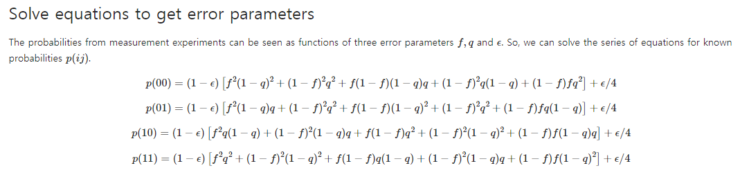
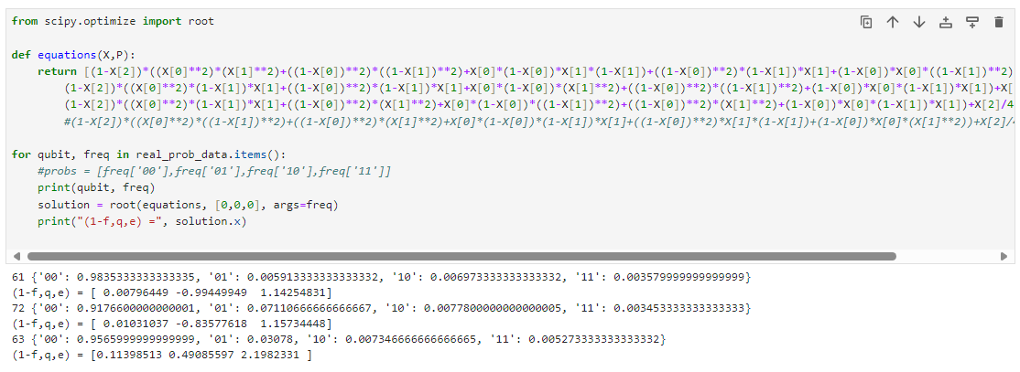

Slide 7
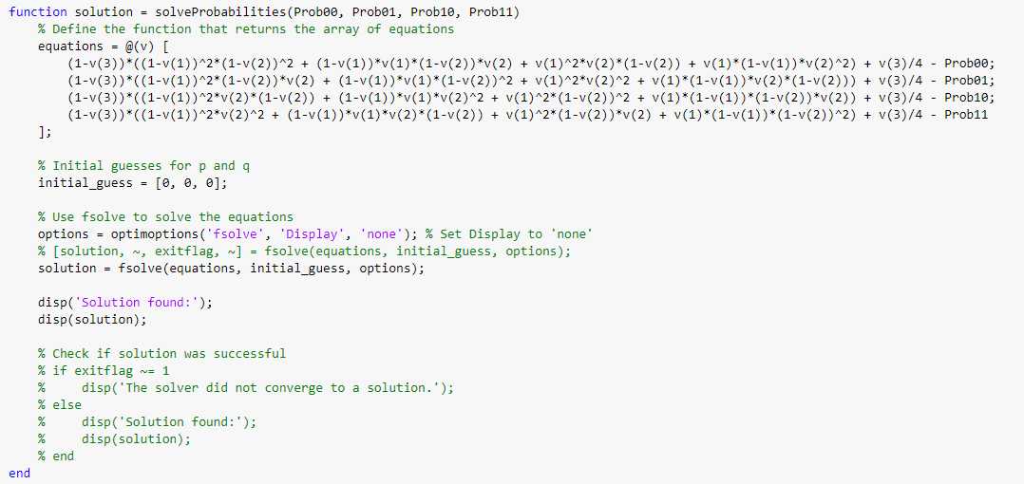
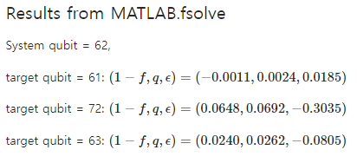

Slide 8
Readout assignment error

Slide 9
